Slide 1

C40 - Connected Clinical Devices
Final Presentation
Ryan Clulo, Sam Norris, Franco Reda, Zhou Shen
Advisor: Dr. Povinelli
Sponsor : Kent Newberry - Direct Supply

Slide 2
Presentation Outline
Project Background
Customer Needs
Justification for Design
Prototype Demonstration
Experimental Verification
Machine Learning Results
Project Legacy

Slide 3
Project Background
With an aging population the number of seniors requiring care is increasing
The variety of medical devices on the market makes over-complicates the information gathering process
Handling data acquired from modern medical devices distracts doctors and nurses from patient care and is inefficient
Direct Supply would like to remove obstacles by gathering all information together via an internet of connected device
Direct Supply wants to understand factors that influence clinical readings and use this information to lead to better living environments and care for elderly individuals
Notes:
Doctors are overburdened

Slide 4
Customer Needs
Hardware
Embedded controller, Direct supply pulse oximeter
Software
Develop app that automate the connection between devices
Use machine learning to analyze correlations in health data
Testing
Verify IoT connectivity, secure/accurate transfer of information, and analysis tools
Machine Learning Correlation Experiment
Gather data from a variety of sources that shows any trends that appear in data
Notes:
software :those algorithms; to figure out what kind of mood users in

Slide 5
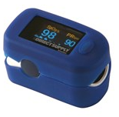
Customer Needs - Hardware
Select an embedded system to be a smart hub for the IoT network
The team chose the Raspberry Pi System for our system
Use the Direct Supply Pulse Oximeter
Hardware
Raspberry Pi 3 (with pre-installed Android OS)
Raspberry Pi 7” Touchscreen Display
Case for Raspberry Pi 7” Display
Direct Supply Pulse Oximeter

Slide 6


Customer Needs - Software
Write software to perform the following tasks:
Interpret Bluetooth protocol and implement software that networks the embedded smart hub and the pulse oximeter
Display data on the embedded system
Store data in a database
Started scripting with Raspbian and switched to an Android App

Slide 7
Customer Needs - Machine Learning Experiment
Design an experiment for analyzing the relationship between the readings that are taken and factors that could influence the readings.
Take enough readings to support analysis in relation to factors that could influence the readings. Analysis of the readings can be done off device
The team used SciPy, NumPy and Weka
The team gathered information from the Physionet

Slide 8
Sponsor Requirements
Budget | 100%
Software on operating system | 100%
Analyze relationship for data | 100%
Developing interface for connecting | 75%
Gather data for correlation experiment | 70%
Acquire and store data | 50%
Notes:
Results and conclusions

Slide 9
Technical Issues: Raspbian and Bluetooth
Started With Raspbian
This was the system the previous group used
Development Benefits
Using Gatttool
Could discover the device and read the GATT headers
Couldn’t read the attributes which held the device info
Got in touch with local company Onkol
Recommended the usage of Android
Minor Incompatibilities between Android on the Pi and our Development environment lead us to display our prototype on a mobile device
Notes:
We know it’s possible

Slide 10
Technical Solutions: Android
The app’s main purpose is to successfully connect with the pulse oximeter
Pulse oximeter does not follow standard BLE and GATT protocol, and expands on the GATT protocol with an added cryptographic check
App is specifically designed to handle these differences automatically
UUIDs are readable after the check is passed and the data can be displayed and used by our embedded system

Slide 11
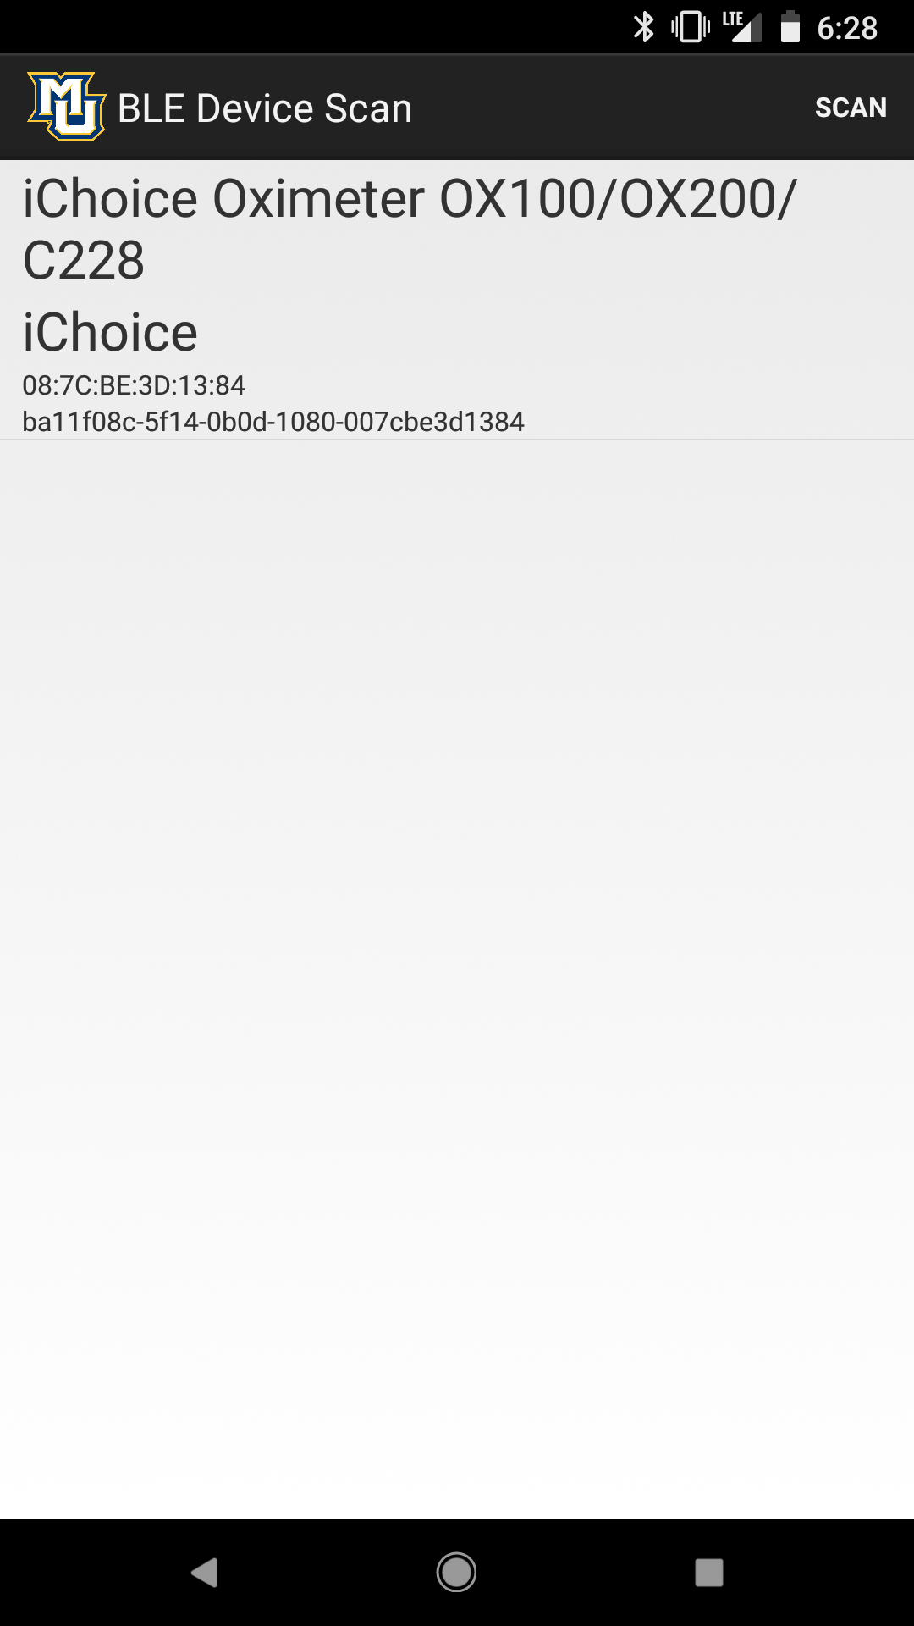
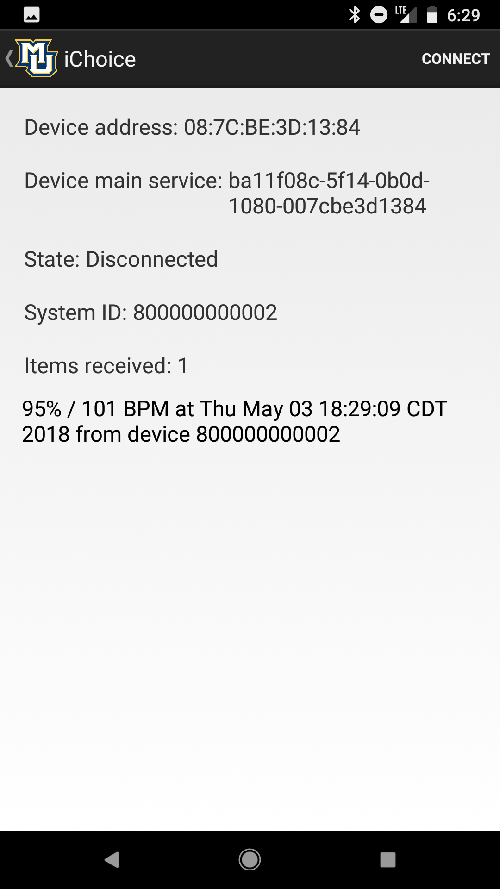
Prototype Demonstration

Slide 12
Experimental Verification
Device connection
Ensuring the device can reliably be connected through our app
Accuracy of received data
Comparing the data we display on our app with the data display on the pulse oximeter
Precision of pulse oximeters
Comparing the data of multiple pulse oximeters to tests their consistency of reporting data

Slide 13
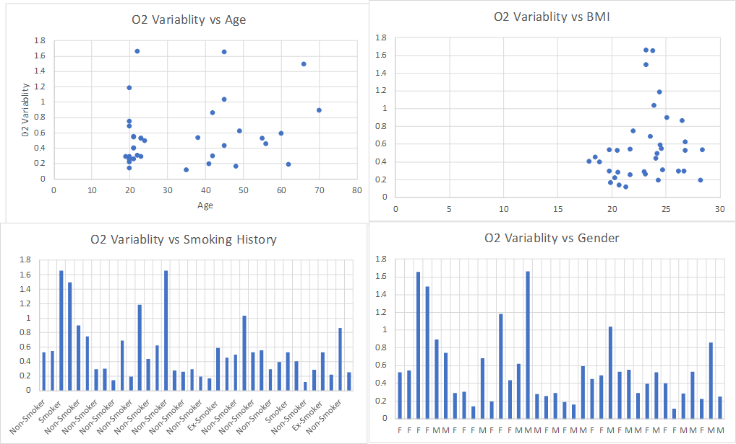
Machine Learning - Data Classification
The team used excel to statistically analyze the Physionet data
The goal was to find a correlation between the tagged attributes and blood oxygen levels
Notes:
Physionet waveform database
2017 Study on Blood Oxygen Variability in aging populations

Slide 14
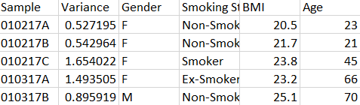
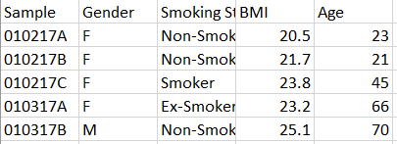
Machine Learning - Python Results
Step 1. Load data, detect outlier and check for null or missing values
Training Data
Testing Data
Notes:
Note book.
Result: fortunately, no outlier, no null or missing value

Slide 15
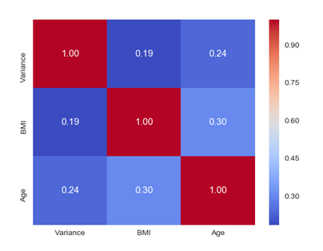
Machine Learning - Python Results
Step 2. Feature Analysis and Engineering - Numerical Value
Notes:
Numerical and categorical values

Slide 16
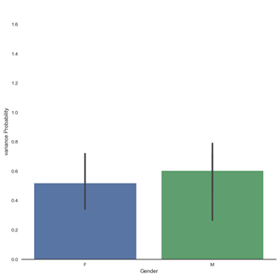
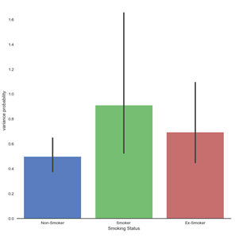
Machine Learning - Python Results
Step 2. Feature Analysis and Engineering - Categorical Value

Slide 17
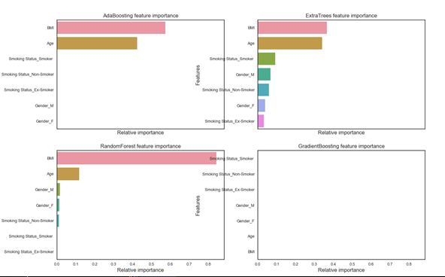
Machine Learning - Python Results
Step 3. Simple modeling and ensemble modeling

Slide 18
Machine Learning - Python Results
Step 4. Prediction for health condition of patients
Sample | Health Condition
010217A | 0
010217B | 0
010217C | 1
010317A | 0
010317B | 0
051216A | 0

Slide 19

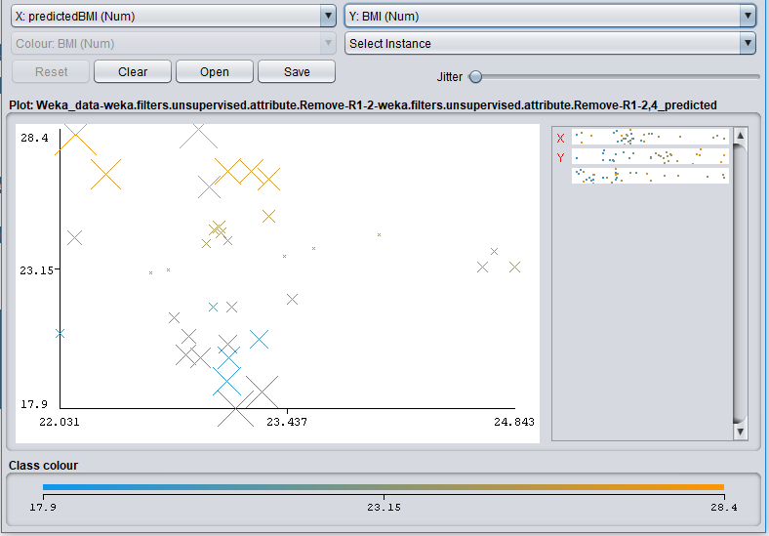
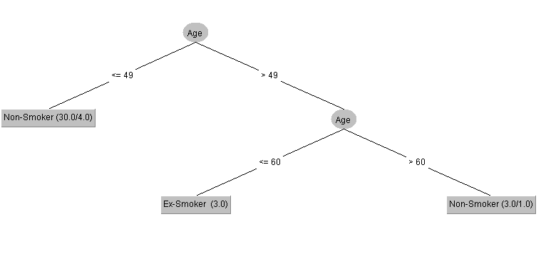
Machine Learning - Weka Results
Used Weka to analyze the data
Decision Trees - Categorical Attributes
Linear Regression - Numeric Attributes
Notes:
University of Waikato

Slide 20
Project Legacy
Huge potential for Internet of Things in the healthcare market particularly in home health applications
Machine learning is very powerful for analyzing large amounts of data collected and acquired by smart systems
Pulse Oximetry has limited application to predicting other health metrics
Significant room for future senior design teams to continue to develop within this space

Slide 21
Questions?
Special Thanks to:
Dr. Tamma
Dr. Povinelli
Kent Newberry & Direct Supply
Tyler Hackbarth & Onkol

